Slide 1
Sorting Interview Notes
Khandaker Mushfiqur Rahman

Slide 2
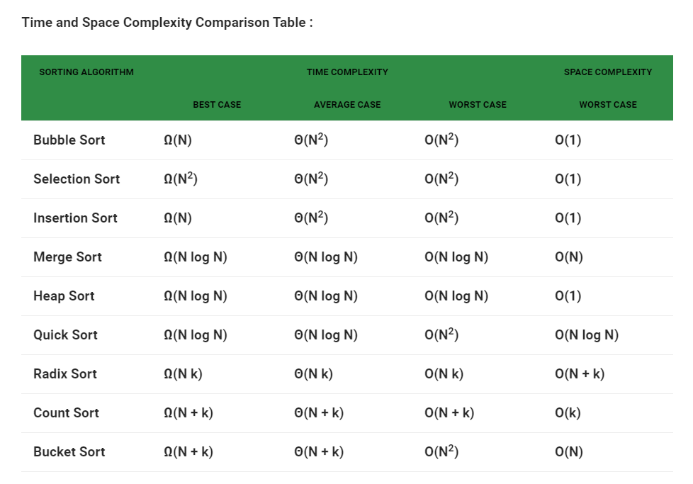

Slide 3
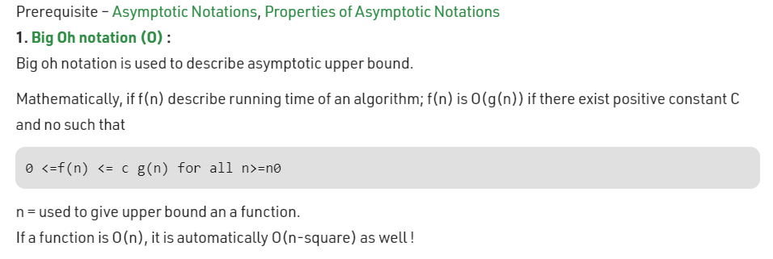
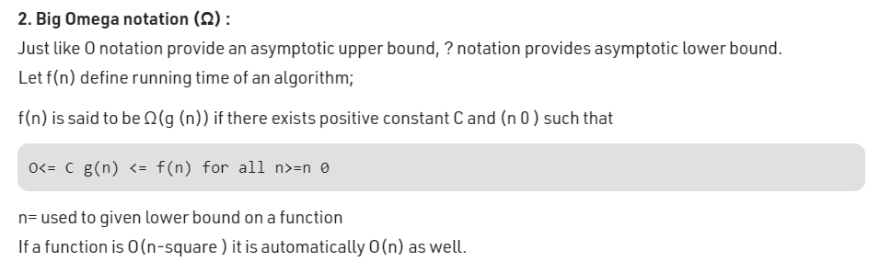

Slide 4

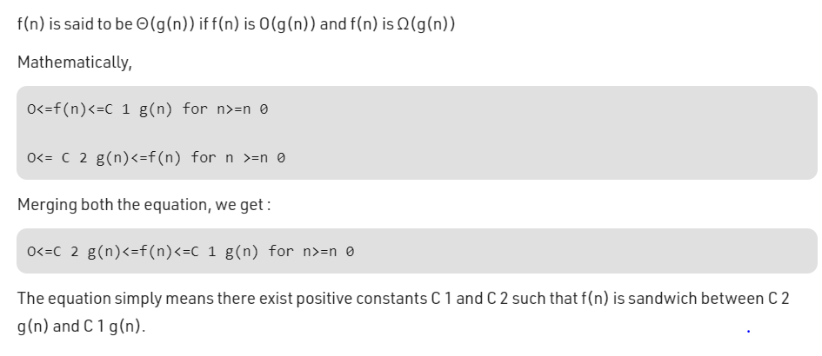

Slide 5
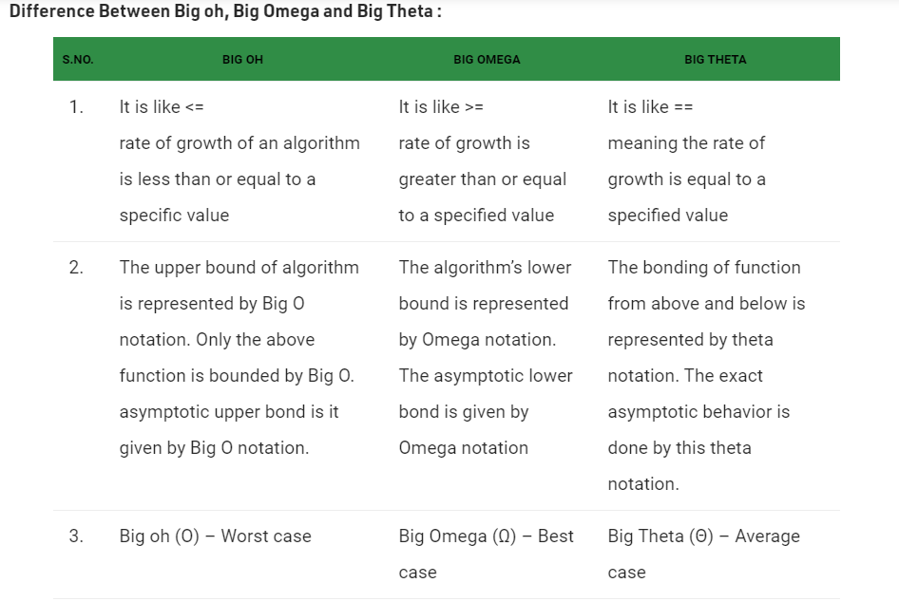

Slide 6
Stability in sorting algorithms
Stability is mainly important when we have key value pairs with duplicate keys possible (like people names as keys and their details as values). And we wish to sort these objects by keys.
Stability is important for the following reason: say that student records consisting of name and class section are sorted dynamically on a web page, first by name, then by class section in a second operation. If a stable sorting algorithm is used in both cases, the sort-by-class-section operation will not change the name order; with an unstable sort, it could be that sorting by section shuffles the name order. Using a stable sort, users can choose to sort by section and then by name, by first sorting using name and then sort again using section, resulting in the name order being preserved. (Some spreadsheet programs obey this behavior: sorting by name, then by section yields an alphabetical list of students by section.)
Which sorting algorithms are stable? Some Sorting Algorithms are stable by nature, such as Bubble Sort, Insertion Sort, Merge Sort, Count Sort etc.
Other non-comparison based sorts such as Counting Sort maintain stability by ensuring that the Sorted Array is filled in a reverse order so that elements with equivalent keys have the same relative position. Some sorts such as Radix Sort depend on another sort, with the only requirement that the other sort should be stable.

Slide 7
Which sorting algorithms are unstable? Selection sort, Quick Sort, Heap Sort etc., can be made stable by also taking the position of the elements into consideration.
Some of them might have a stable implementation. It can be stable - normally, only with linked lists.
(key point, insert the element instead of swapping)
https://www.geeksforgeeks.org/stable-selection-sort/
Runtime becomes O(N^3) (no links or proves found, I calculated myself)
This change may be done in a way which does not compromise a lot on the performance and takes some extra space, possibly theta(N).

Slide 8
IN-PLACE and OUT of PLACE
An in-place algorithm is an algorithm that does not need an extra space and produces an output in the same memory that contains the data by transforming the input ‘in-place’. However, a small constant extra space used for variables is allowed.
Inplace sortings : bubble , insertion, selection, heap , quick sort
Out of place sortings : merge sort, count sort
Merge sort also has an inplace implementation. It takes O(nlog^2n) worst case time complexity.

Slide 9
Online Sorting Algorithms:
An online sorting algorithm is one that will work if the elements to be sorted are provided one at a time with the understanding that the algorithm must keep the sequence sorted as more and more elements are added in. Algorithms that assume that the entire input will be given in advance, such as heapsort, will not work as online algorithms because they presume that they know all the elements in advance. On the other hand, an algorithm like insertion sort is online, since it purely works from the left to the right and doesn't need to see the entire array as it's working until it tries to process the very last element.

Slide 10
Bubble sort:
Doesn’t out perform any of the other 6 sorts we are talking about
Can be optimized implemented to detect if the list is sorted in O(n) time. So the best case runtime is O(n)
For opt implementation, just see if the inner loop is making any swaps or not. If not, then break the upper loop.
After k-th iteration, last k elements have the largest k elements

Slide 11
Selection sort:
out performs bubble sort
Slower than Insersion sort
After k-th iteration, first k elements are sorted
Not online
Heap sort is a more optimized version of Selection sort
cocktail sort/double selection sort is a faster variant
In cocktail sort, finds both the minimum and maximum values in the list in every pass. This reduces the number of scans of the input by a factor of two. Each scan performs three comparisons per two elements (a pair of elements is compared, then the greater is compared to the maximum and the lesser is compared to the minimum), a 25% savings over regular selection sort
Selection sort can be implemented as a stable sort. If, rather than swapping in step 2, the minimum value is inserted into the first position (that is, all intervening items moved down), the algorithm is stable. However, this modification either requires a data structure that supports efficient insertions or deletions, such as a linked list, or it leads to performing Θ(n²) writes.

Slide 12
Insertion sort:
out performs bubble sort and selection sort
After k-th iteration, first k elements are sorted
Best for almost sorted arrays
One of the Fastest algorithm for sorting small input array
In a permutation a1.....an of n distinct integers, an inversion is a pair (ai, aj) such that i < j and ai > aj.
Insertion sort runs in Θ(n + f(n)) time, where f(n) denotes the number of inversion initially present in the array being sorted.
So if there are n inversions, the running time would be O(2n) or O(n)

Slide 13
Question: In which comparison sorting, serial of the input doesn’t matter?
Answer: Selection sort, Merge sort, Heap sort as they have same best and worst case runtime.
Question : is Heap sort the best sorting algo?
Answer: no, it has a problem of no being stable.
Question: which algorithms are used in STL implementations in c, cpp, java and python?
Answer:
C’s qsort() – Quicksort
C++’s sort() – Introsort (Hybrid of Quicksort, Heap Sort and Insertion Sort)
C++’s stable_sort() – Mergesort
Java’s Collections.sort() – Mergesort
Python’s sorted() – Timsort (Hybrid of Mergesort and Insertion Sort)
Python’s sort() – Timsort (Hybrid of Mergesort and Insertion Sort)
For details,
https://www.geeksforgeeks.org/know-sorting-algorithm-set-1-sorting-weapons-used-programming-languages/

